Slide 1
Who was your favourite teacher and why?

Slide 2
The Inclusive Classroom – Methods, Diversity, and Anti-Discrimination Workshop

Slide 3

Inclusive education
-- promotes equal participation and learning opportunities for all students.
-- encourages cooperation, empathy, and differentiated learning.
-- The teacher’s role is to create a safe, respectful, and supportive environment.
Adapting support according to students’ needs rather than treating everyone identically.
Modern European education systems increasingly focus on inclusion and student wellbeing.

Slide 4
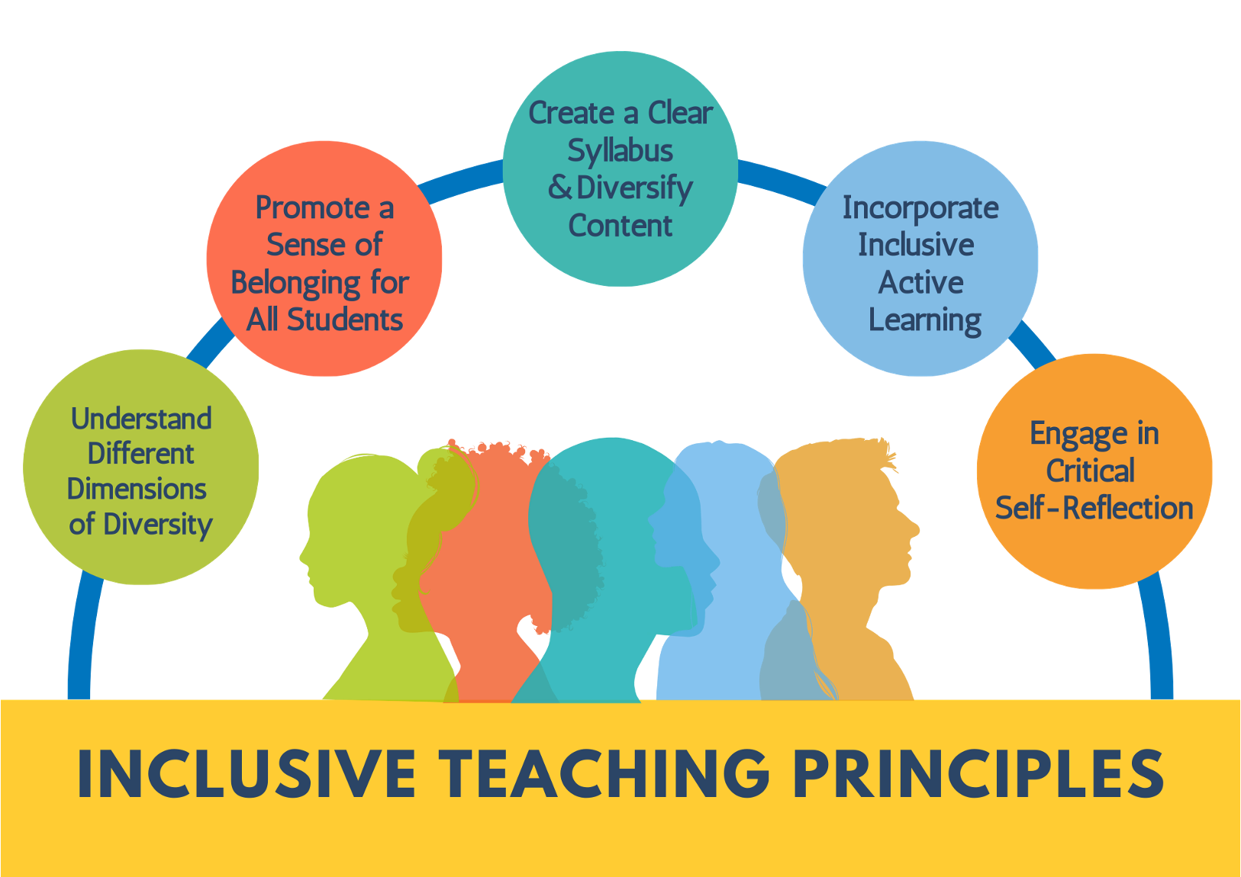
Teaching
Inclusive teaching is less about creating different lessons and more about increasing flexibility within one lesson.

Slide 5
1. What is the role of a teacher in an inclusive education?
2. How do teachers’ expectations influence student success?

Slide 6
Special needs students
Gifted students- there is yet no official strategy or legislation for gifted students; just a framework
Students with disabilities (autism, dyslexia, dysgraphia, emotional problems, ADHD….)- Individualized and adapted programme

Slide 7
Main categories of difficulties
1. Learning difficulties or learning disabilities
2. Intellectual or cognitive disabilities
3. Communication and language difficulties
4. Autism spectrum conditions
5. Attention and behavioral difficulties
6. Emotional and mental health difficulties
7. Sensory impairments
8. Physical disabilities or health conditions
9. Multiple or complex needs

Slide 8
Individualized vs. adapted programme

Slide 9
INDIVIDUALIZATION | ADAPTED PROGRAMME
Used for mild difficulties; student follows the regular curriculum. | moderate to severe difficulties; curriculum content and outcomes are modified.
Only teaching methods, instructions, and assessment conditions are adapted. | Curriculum, scope, and outcomes are adapted or reduced.
Suitable for students with: dyslexia, dysgraphia, dyscalculia. | Suitable for students with intellectual disabilities (mild, moderate, severe).
Suitable for students with ADHD / ADD. | Used for autism with significant impairment.
For mild emotional/social difficulties. | For multiple disabilities.
For gifted students (enrichment, acceleration). | For significant speech-language impairments.
For students learning Croatian as a second language. | For visual or hearing impairments requiring changed outcomes.
For temporary difficulties (illness, absence). | For motor disabilities affecting access to curriculum.
Student meets regular educational outcomes. | Student follows modified or alternative outcomes.
 | Requires formal administrative decision

Slide 10
In practice
Individualization – Examples for a Student With Dyslexia | Adapted Programme – Examples for a Student With Multiple Disabilities
• Provide texts in enlarged font with increased spacing and allow extra time for reading. • Allow oral answers instead of written ones and reduce visual clutter on worksheets. • Use multisensory reading strategies (colour overlays, reading ruler, audiobooks). | • Reduce curriculum outcomes to focus on functional skills appropriate to cognitive level. • Replace abstract tasks with concrete, hands-on learning supported by visual schedules and symbols. • Assess through observation and simple practical demonstrations instead of written tests.

Slide 11
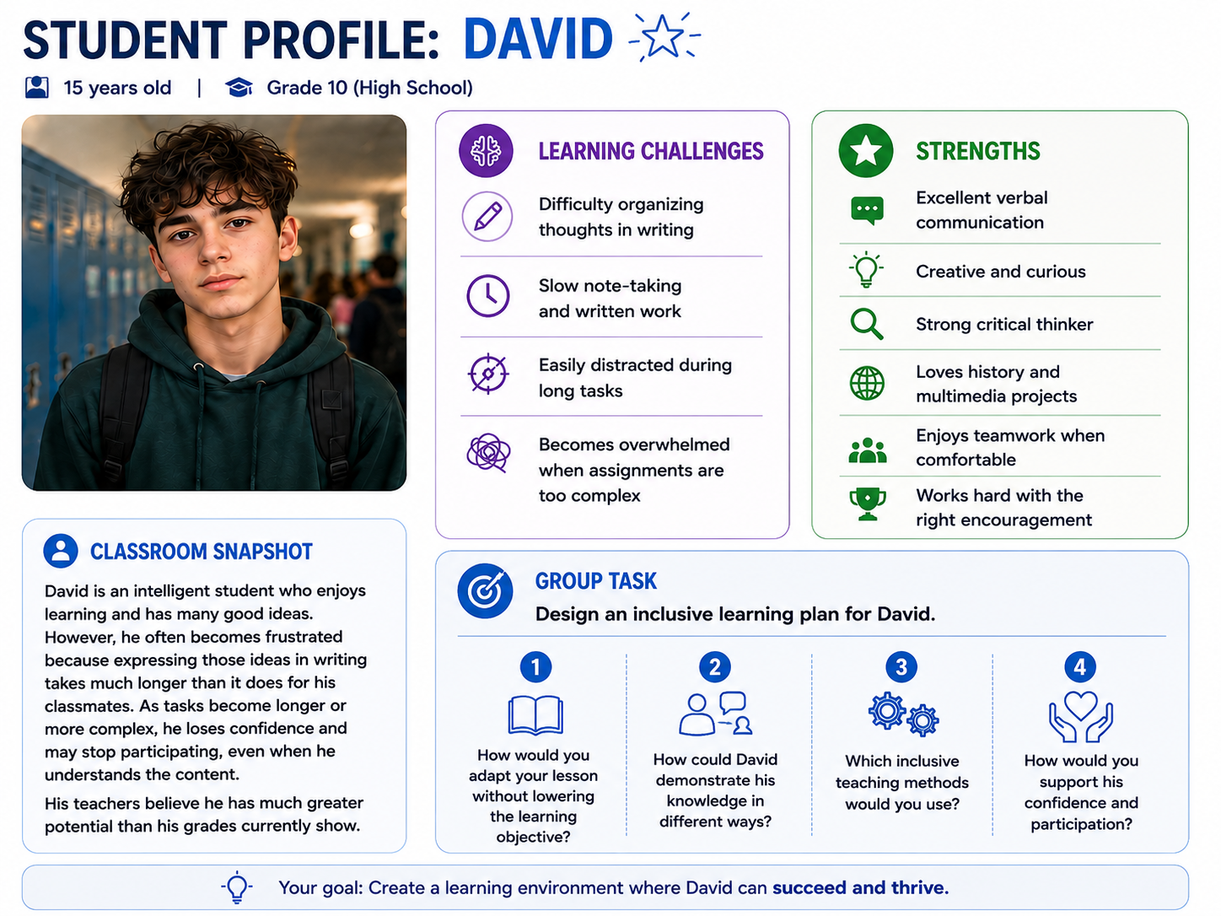
How would you do it?

Slide 12
Dyslexia
&
Dysgraphia
Provide audiobooks and text-to-speech tools.
Allow oral instead of written assessment when appropriate.
Use larger fonts and increased spacing between lines.
Highlight key words and instructions.
Break reading tasks into smaller sections.
Give extra time during tests and assignments.
Use multisensory teaching methods.
Reduce copying from the board.
Provide guided notes or lesson summaries.
Focus grading on understanding rather than spelling errors.
Allow project-based or visual assessment.

Slide 13
ADHD
(Attention Deficit Hyperactivity Disorder)
Use short and clear instructions.
Break tasks into smaller parts.
Include movement breaks.
Use visual schedules and timers.
Provide frequent positive feedback.
Use checklists for organization.
Maintain predictable classroom routines.
Give immediate and structured consequences.
Allow shorter assessment periods with breaks.
Use oral, practical or interactive forms of assessment.

Slide 14
Autism Spectrum Disorder
Use visual schedules and routines.
Reduce sensory overload in the classroom.
Use concrete and literal language.
Provide structured social interaction.
Create predictable classroom routines.
Allow access to calming spaces.
Use visual supports during communication.
Break group work into clearly defined roles.
Support emotional regulation with visual tools.
Alternative assessment formats - presentations or projects.

Slide 15
Speech and Language Difficulties
Use simple and clear language.
Give one instruction at a time.
Use pictures and gestures.
Allow extra response time.
Check understanding frequently.
Encourage alternative communication methods.
Repeat and rephrase instructions.
Pair verbal instructions with written supports.
Avoid rushing the student during speaking.
Collaborate regularly with a speech therapist.
Allow visual or practical demonstrations of knowledge.

Slide 16
Intellectual Disabilities
Simplify learning goals.
Use concrete examples and demonstrations.
Teach one concept at a time.
Repeat information frequently.
Use visual and hands-on materials.
Provide step-by-step guidance.
Adapt the amount of work.
Focus on functional and practical skills.
Allow additional practice opportunities.
Reinforce success immediately and positively.
Use individualized assessment criteria.

Slide 17
Emotional and Behavioral Difficulties
Use restorative conversations instead of punishment alone.
Create clear and predictable rules.
Teach emotional regulation strategies.
Provide calm-down spaces.
Reinforce positive behavior consistently.
Avoid public criticism or humiliation.
Build trusting teacher-student relationships.
Identify triggers for escalation.
Maintain consistent communication with parents.
Allow assessment in low-stress environments.
Consider progress and effort as part of grading.

Slide 18
Anxiety Disorders
Allow gradual participation.
Give extra processing time.
Provide predictable classroom routines.
Offer alternative participation methods.
Use calm and supportive communication.
Prepare students for changes in advance.
Avoid forcing public speaking unexpectedly.
Break overwhelming tasks into smaller parts.
Reinforce effort rather than perfection.
Individual assessment instead of public performance.

Slide 19
Hearing
& visual impairment
Seat the student near the teacher.
Face the class while speaking.
Use captions and visual aids.
Provide written instructions.
Reduce background noise.
Use assistive listening devices.
_______________________________
Provide enlarged print or Braille materials.
Use tactile learning materials.
Describe visual information verbally.
Ensure accessible classroom organization.
Allow assistive technology.
Increase contrast in materials.
Read written information aloud.

Slide 20

Teaching Students from Different Cultural Backgrounds

Slide 21
diversity in the classroom
Culture is often reduced to visible differences such as language, clothing, or traditions.
But, culture influences something much deeper: how students think, communicate, ask questions, interpret authority, solve problems, and even define success.
Every student enters the classroom carrying what psychologists call a cultural lens.
students who feel their identity is recognized and respected demonstrate greater classroom participation, stronger academic motivation, and a stronger sense of belonging.
Sense of belonging → positively contributes to well-being

Slide 22
Include cultural differences in your teaching
History – WWII - students compare how the same historical event is described in different countries and discuss why these differences exist.
Math – percentages – plan a budget for a family or community event
Psychology – non-verbal communication; things visitors should know about my country
….

Slide 23
How do we teach students to evaluate information when their backgrounds offer completely different worldviews? – an example
Step 1: The 'De-Centering' Anchor:
Present a historical event or contemporary news story from two wildly differing European media perspectives.
Step 2: The 3-Lens Analysis:
Have students analyze the text: What are the stated facts? What are the unstated assumptions? What emotional language is used to trigger the reader?
Step 3: The Role Reversal Switch:
Students must present the opposing side's logic as clearly and fairly as possible, even if they disagree with it.
Debate is also a good method for this.

Slide 24
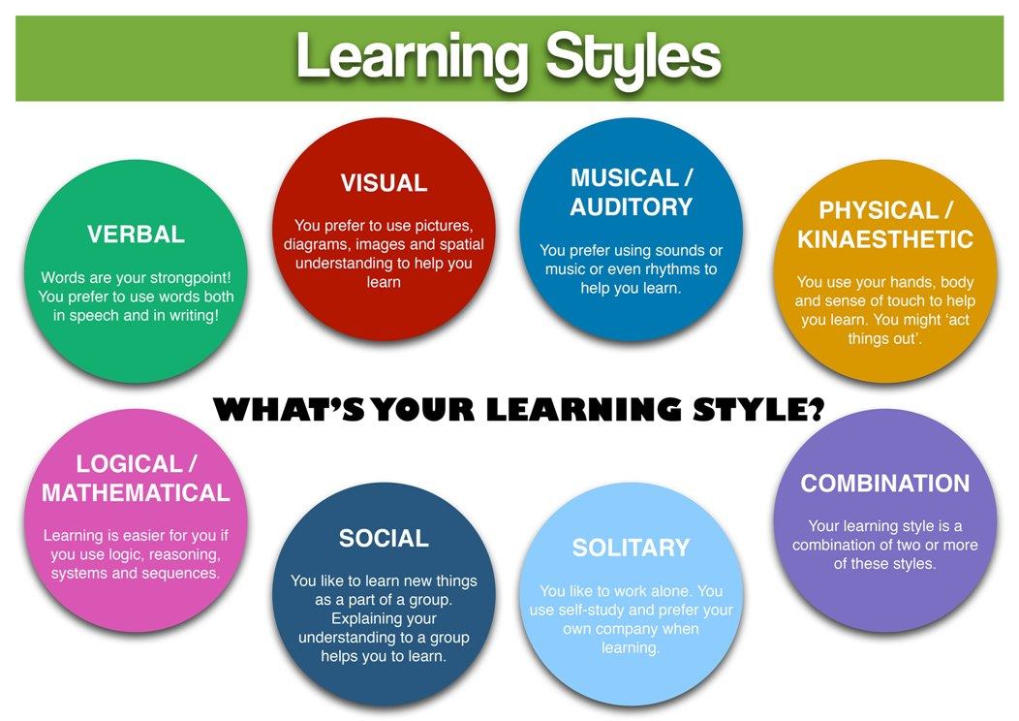
Teaching Students with Different Ways of Learning
Notes:
Learning styles refer to the specific ways individuals prefer to process, understand, and retain information. The most popular framework is the VARK model, which categorizes learners into four main types: Visual (seeing), Auditory (hearing), Read/Write (text), and Kinesthetic (doing)

Slide 25
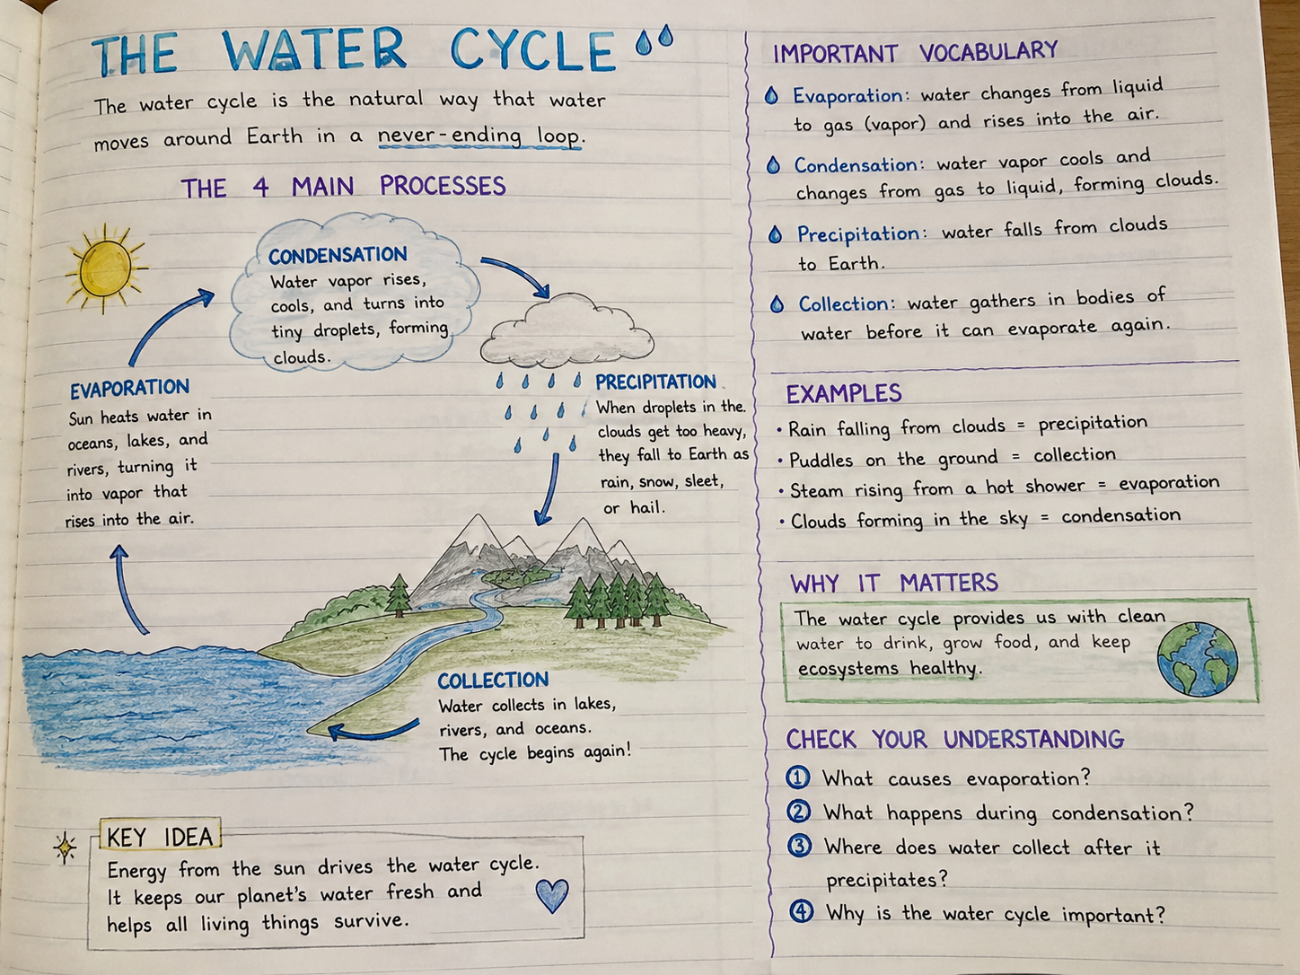
visual
Tips for optimizing the visual learning experience:
**Build lessons and assignments around visual aides.
**Use maps, itineraries, articles, and photos to process and memorize information
**Allow taking notes – whether that be text, drawing, or charts.
**Instruct students to go through notes and ask questions – then modify as needed.
**give sketching assignments
**offer a visual hand-out at the end of each lecture
Notes:
Visual-linguistic learners best process information through writing and reading, thrive in lessons presented in text-driven formats, and are quite keen on taking notes. They memorize information through exercises that draw on their linguistic strengths and are able to express themselves sincerely through words.
Visual-spatial learners - words are not their forte; they instead prefer images, infographics, and artistic renderings. They memorize faces, places, sights, and locations by taking a mental picture and using the image to process associated feelings.

Slide 26
kinesthetic
Tips :
**Make activities as active as possible.
**When learning a new language, engage in conversation regularly.
**Background music or other audio stimulation
**Highlight key points and/or draw sketches of the material.
**give them more time if necessary
**Sensual stimuli such as foods, drinks, and physical objects that the learner can touch or interact with can be of immense help.
**Make complex tasks visual and interactive.
They like to touch, taste, smell, and be active within the lesson in order to best process and remember what they are learning.
They struggle when a lesson or activity is too sedentary. There are two types of kinesthetic learners:
Kinesthetic (movement) - This type wants a deep dive where they are fully engaged with the material and can learn from the experience. External stimulation is the key to success.
Tactile (touch) – they have trouble sitting still –
Love to write down what they learn just to feel their hand move
Notes:
These adjustments also work for students with ADHD

Slide 27
auditory
Tips:
**Begin lessons and presentations with an overview of the process.
**Finish a document or presentation with a summary, giving the auditory learner a chance to recap.
**Socratic method of lecturing (cooperative, argument-based dialogue where teachers ask probing questions instead of lecturing)
**Inclusive activities.
**Recitation activities. The more conversational, the better!
They often talk out loud to themselves - that helps them process thoughts and ideas
When reading they tend to recite text out loud.
If in a location where that is not appropriate or doable, they’ll move their lips as the read.
While they benefit greatly from speaking, the auditory learner often struggles with remembering what they read, or in putting their thoughts to paper.

Slide 28
bEyond the myth of learning styles
"She's a visual learner."
"He's an auditory learner."
"They learn best through movement.“
"How can I present information in several ways so every learner has multiple opportunities to understand it?"

Slide 29
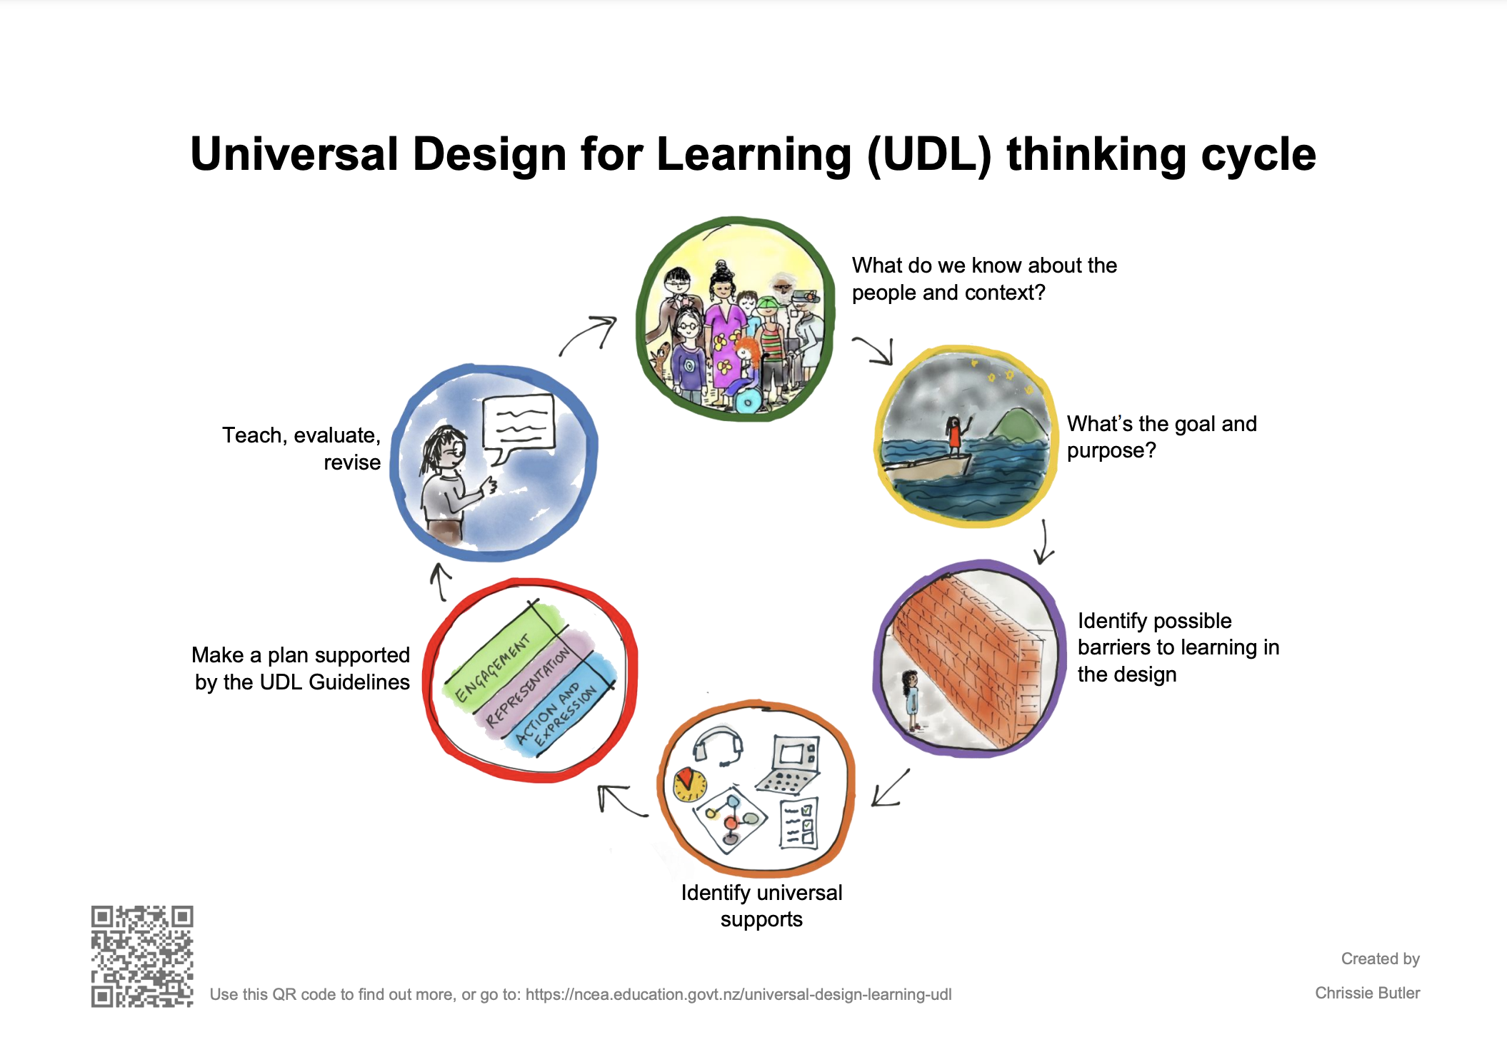
Teaching strategies
Universal Design for Learning (UDL) provides multiple ways of engagement and assessment.
--Multisensory teaching improves participation and retention of knowledge.
--Group work and peer support strengthen inclusion
--Digital tools help personalize learning and increase accessibility.

Slide 30
examples
Verbal instructions with pictures, written steps, different ways of presenting knowledge (orally, written essay, video…), audiobooks, enlarged text, interactive games, hands-on activities, digital tools

Slide 31
Group work! – consultancy files
You are a part of an educational consultancy team.
Tomorrow morning, a teacher will walk into her classroom and teach an important lesson. She has one student who is bright, capable, and full of potential—but traditional teaching methods simply aren't allowing that student to demonstrate what he really knows.
She has reached out to your consultancy team because she needs practical advice. Your mission is to help her.
Each team will receive a consultancy file containing the same student profile and the same classroom challenge.
Your goal is simple: work together to develop the best possible solution.
You will have 20-30 minutes to work together.
Then, 5 minutes to present.

Slide 32
handout for teachers

Slide 33

Beyond First Impressions:
Recognizing Bias
& building Inclusive Classrooms

Slide 34


The Biology of Bias:
Why Our Brains Do This
We make tens of thousand decisions daily!
Heuristics = mental shortcuts – they allow people to solve problems and make judgments quickly and efficiently
relying on them can sometimes lead to systematic errors known as cognitive biases.

Slide 35
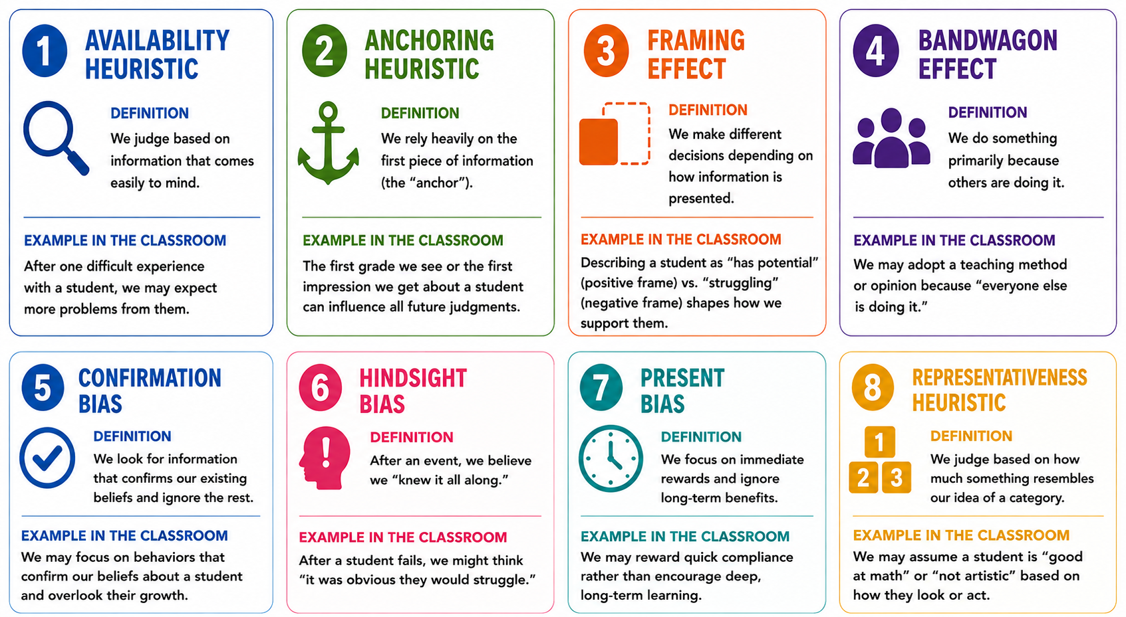

Slide 36
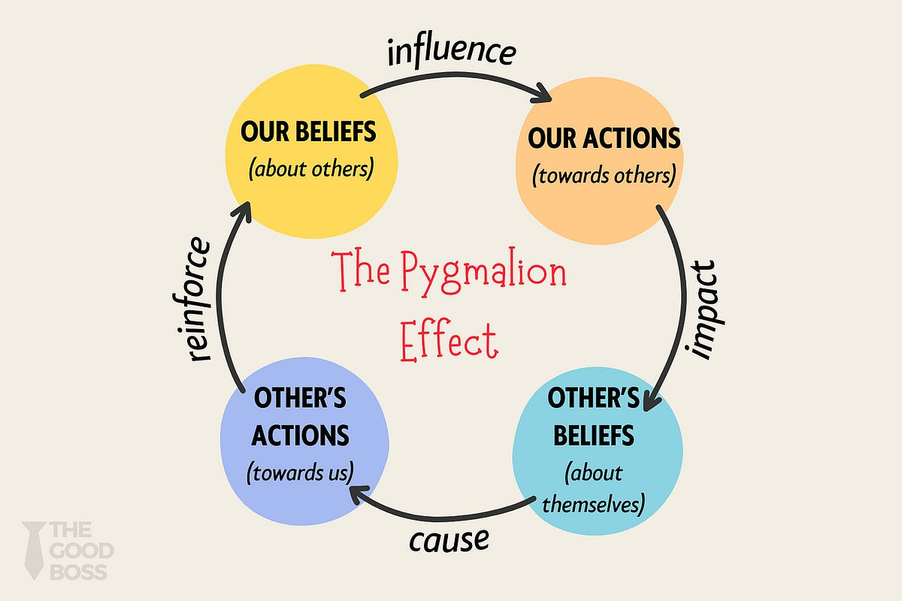
Hidden bias traps in school
The Pygmalion Effect
(Self-Fulfilling Prophecy):
When a teacher expects lower performance from a student (e.g., assuming a student from an immigrant background or lower socioeconomic status will struggle)
they subtly alter their teaching behavior—giving less praise, shorter wait-times for answers, or less challenging work.
The student internalizes this, performs poorly, and "confirms" the teacher's original bias.
The Rosenthal Experiment, 1965*

Slide 37
Stereotype (Cognitive): Oversimplified beliefs, assumptions, or generalizations about a group of people based on their identity (can sometimes be positive)
Prejudice (Emotional): Unjustified, negative attitudes or feelings toward individuals based solely on their group membership.
Discrimination (Behavioral): Unequal, unfair, or harmful actions taken against individuals or groups due to these prejudices

Slide 38
Group work: how to prevent bullying in schools?
Imagine the European Commission has asked us to develop practical recommendations for schools across Europe on one important question:
How can schools prevent bullying?
Each table has received an expert sheet. However, there is one important condition...
No group has the complete picture.
Each of you has access to only one part of the evidence. Your job is to become an expert on your topic. Discuss the information, agree on the two most important ideas, and be prepared to explain them later.
You have 5 minutes.
Good luck.

Slide 39
Let’s reflect…
1. Could your original group have solved the challenge alone?
2. Why did you need the other experts?
3. Who became the most valuable person in your final group?

Slide 40
JIGSAW CLASSROOM (Aronson, 1971.)
Every learner holds one essential piece of knowledge.
Success is only possible when everyone contributes.
Research has consistently shown that the Jigsaw Classroom reduces stereotypes, increases empathy, improves academic achievement, and creates a stronger sense of belonging
**it demonstrates that inclusion is not achieved by treating everyone the same, but by designing learning experiences where every student is needed, valued, and able to contribute.

Slide 41
What have you learned today? - recap

Slide 42
Some useful digital tools
If you want to... | Use this tool | What it does
Adapt any text to different reading levels | Diffit | Simplifies texts, creates questions and worksheets instantly.
Save lesson planning time | MagicSchool AI | Generates lesson plans, rubrics, quizzes and classroom activities.
Make every student participate | Padlet | Digital collaborative board where everyone can share ideas anonymously or publicly.
Create digital books and projects | Book Creator | Students can combine text, images, audio and video in one project.
Support struggling readers | Reading Coach | Gives students personalized reading practice and pronunciation feedback.

Slide 43
Thank you! ☺

