Slide 1
Connection in Action – Conflict Prevention and Collaboration

Slide 2
Conflict is not the opposite of connection.
It is often a signal that connection has been weakened.

Slide 3
Conflict is rarely about the behaviour itself.
It is usually driven by:
unmet psychological needs
fear
exclusion
misunderstanding
competition
stress
emotional dysregulation

Slide 4
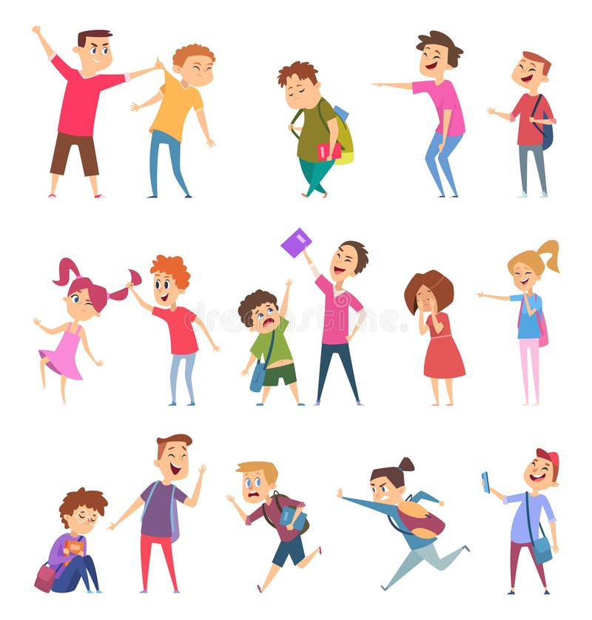
Why conflict happens

Slide 5
Morton Deutsch’s Theory of Conflict Resolution (1973, 2006)
Two Types of Classroom Conflict:
Interpersonal: Clashes of personality, communication styles, and cultural norms.
Structural: Created by the environment, rules, and how activities are set up.
The Crucial Shift: Changing the environment is easier than changing a personality.

Slide 6
Example:
If your grading system forces students to compete against one another for top marks, you have structurally engineered conflict.
Before a student even opens their mouth, the system has set them up to clash.
The good news? It is much easier for you to fix a structural design flaw than it is to change a student's personality.

Slide 7
The Five Styles of Conflict Engagement
The Thomas-Kilmann Conflict Mode Instrument (TKI)
Two Axes: Assertiveness (focus on my needs) vs. Cooperativeness (focus on your needs).
The 5 Modes:
Competing: High assertiveness, low cooperativeness. (I win, you lose)
Accommodating: Low assertiveness, high cooperativeness. (I lose, you win)
Avoiding: Low assertiveness, low cooperativeness. (Nobody wins)
Compromising: Mid assertiveness, mid cooperativeness. (We both give up something)
Collaborating: High assertiveness, high cooperativeness. (We find a third way) → the ultimate goal!

Slide 8
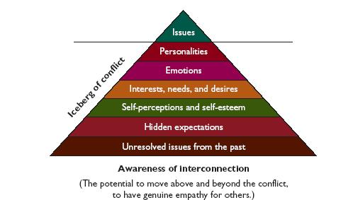

Slide 9
Think about one conflict that repeatedly appears in your own classroom.
Rather than trying to change your students first, ask yourself:
What is one thing I could do differently?

Slide 10
Common Sources of Classroom Conflict
unclear expectations
perceived unfairness
poor communication
competition
cultural misunderstandings
emotional overload
lack of belonging

Slide 11
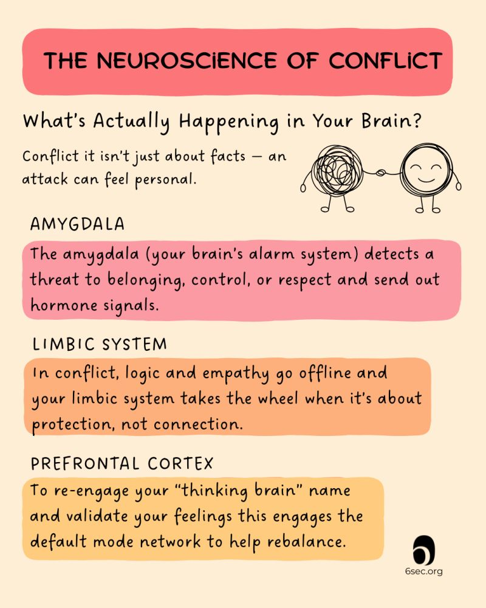
The Brain During Conflict
your brain shifts into survival mode.
The amygdala—identifies emotional threats as physical danger → flood of cortisol and adrenaline → impairs the prefrontal cortex (responsible for reasoning and impulse control) = incredibly difficult to think clearly or communicate calmly

Slide 12
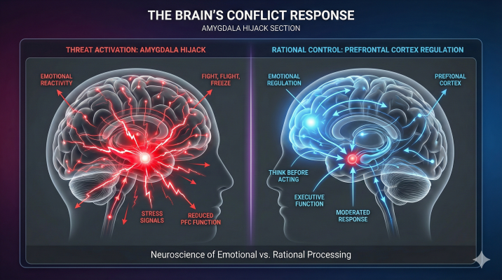
Neurosception: Your brain constantly scans for safety or danger in the other person's facial expressions, tone, and body language. A sharp tone or expression can instantly flip you into fight-or-flight mode.
Mirror Neurons: These cells make us mimic the emotions of others. When someone escalates, our mirror neurons want to match that emotional tone, causing an escalating feedback loop.
Right Brain Dominance: In tense situations, the right hemisphere of the brain (which processes nonverbal cues, emotions, and the "big picture" of safety) takes over.
Stress reduces our ability to:
think clearly
solve problems
empathize
control impulses

Slide 13
Preventing Conflict
Healthy classrooms are built on:
belonging
predictability
trust
student voice
psychological safety
Conflict prevention begins long before any disagreement occurs.
Research consistently shows that students who feel they belong are less likely to engage in disruptive behaviour.
Carol Dweck → classrooms should reward learning rather than perfection
Robert Pianta → positive teacher-student relationships are among the strongest predictors of engagement.
Small routines: greeting students at the door, learning names quickly, creating predictable transitions, giving students meaningful choices, and ensuring that every learner feels seen.

Slide 14
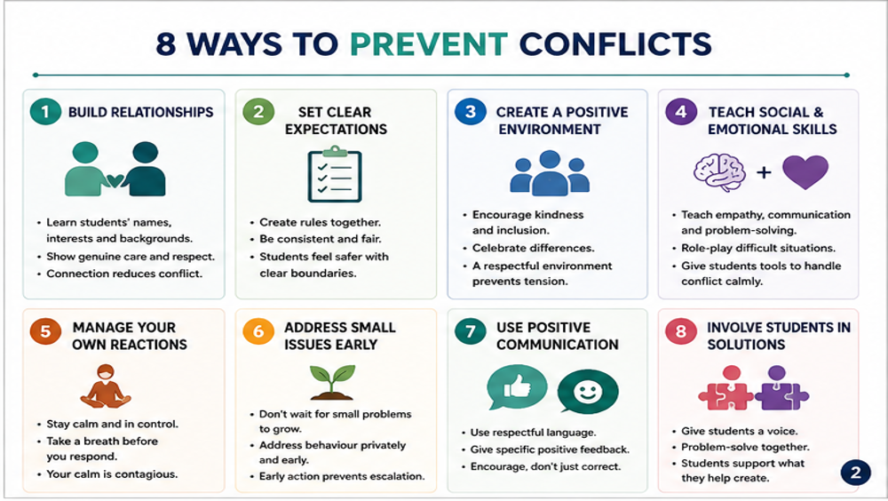

Slide 15
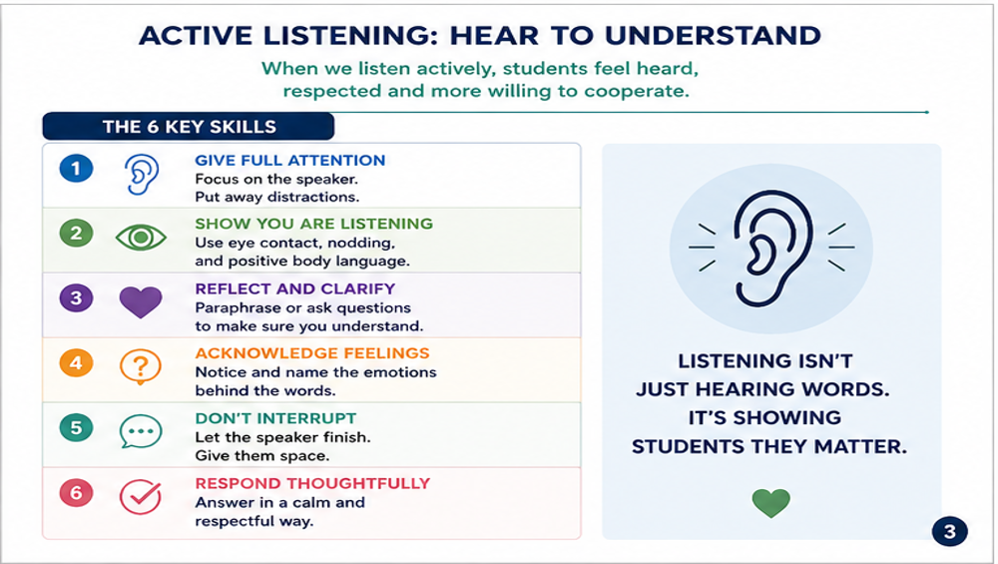

Slide 16
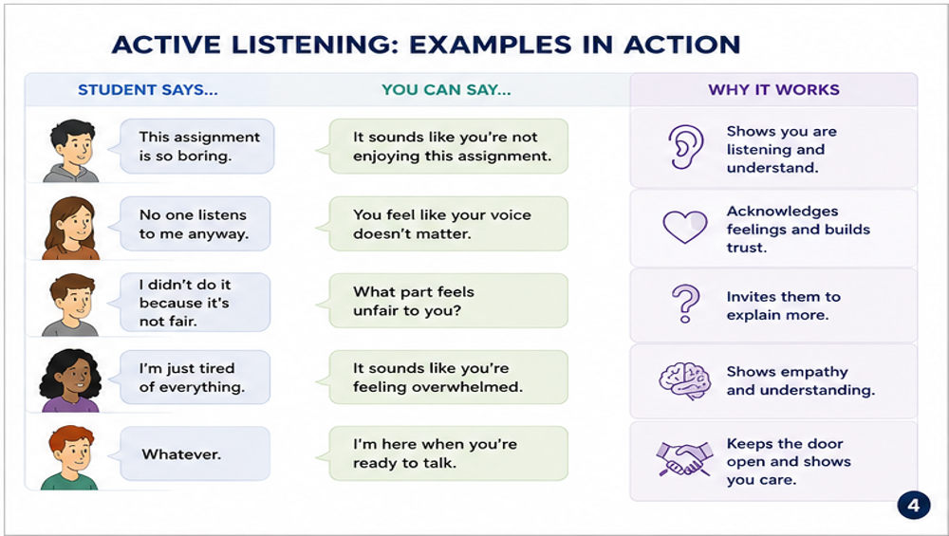

Slide 17
Listen to Understand, Not to Respond
One participant takes the role of Teacher A and shares a real classroom challenge or difficult interaction with a student for 2 minutes (or just talks about their day)
The listener's goal is not to solve the problem.
Instead, use active listening by:
paraphrasing what you hear,
reflecting the speaker's emotions,
asking open-ended questions,
checking that you understood correctly.

Slide 18
Think…
You are having dinner with your family or watching TV when, suddenly, you hear a woman’s scream outside of your building:
a) I would immediately go outside.
b) I would call the police.
c) I would look through the window first.
d) I would assume someone else had already called.
e) I'm honestly not sure.

Slide 19

The Bystander Effect
(darley & latane, 1968.)
Murder of Kitty Genovese in New York(1964.)
- Spurred the psychological concept of the bystander effect.
- Initial press reports falsely claimed 38 neighbors watched and ignored her prolonged assault, though later investigations revealed the story was heavily exaggerated and ultimately led to the creation of the 911 emergency system.

Slide 20
In classroom
Who is today’s Kitty Genovese? (not literally, but…)
the isolated student
the bullied student
the student nobody chooses
the quiet student
the student who suddenly stops participating
"How many classmates notice?"
"How many act?"

Slide 21
Write down reasons a student might stay silent when witnessing bullying.

Slide 22

Anti-Bullying Support and Social Inclusion
Children with special needs are statistically more vulnerable to bullying and exclusion!
Teachers must recognize early warning signs of emotional or social difficulties.
A culture of acceptance is built through empathy, classroom rules, and positive modeling.
Peer mentoring and restorative approaches reduce conflict and isolation.
Social-emotional learning improves communication and emotional regulation.

Slide 23
How can we teach people to help?
1. "That's not okay. We don't speak to each other like that.“ "Let's stop. That comment wasn't funny.“– when it feels safe and the person intervening is confident
2. "Hey, can you help me with this question?"
"Teacher, our group needs some help.“ – remove attention from bullying
3. Get help - another student quietly tells the teacher after class
4. "Hey... I saw what happened earlier. Are you okay?“ - This reduces isolation and encourages reporting.
5. If the bullying continues online or repeatedly occurs: Save screenshots, write down what happened, report it through school procedures.
Documentation should support the victim—not become gossip.
Intervention can be learned!
Five Ways to Help:
1. Direct – Speak up respectfully.
2. Distract – Interrupt the situation without confrontation.
3. Delegate – Get support from another student or adult.
4. Delay – Check in with the person afterwards if immediate action isn't safe.
5. Document – Record evidence when appropriate and report it through the correct channels.

Slide 24
What can teachers do?
1. DIRECT - "Let's pause for a moment. In this classroom, we don't make comments about someone's identity or the way they speak. Everyone deserves to feel respected here.“ - Address the behaviour (not students’ character) respectfully and immediately.
2. DISTRACT - "I'd like every group to stop for one minute. Each person will now explain one idea their partner contributed.“ (disagreement escalates during group work) - Interrupt the situation before it escalates.
3. DELEGATE – involve school counsellors, another teacher, parents, peer mediators… - Involve others when appropriate.
4. DELAY - "I noticed what happened earlier. How are you feeling? Is there anything you'd like to talk about?“ - Follow up after the incident.
5. DOCUMENT - "At 10:15, student A called Student B 'idiot' during group work. Three classmates laughed. Student B became silent and withdrew from the activity.“ - Keep objective records when patterns emerge. (extremely important as a teacher!)

Slide 25
Activity:
You Are the Teacher

Slide 26
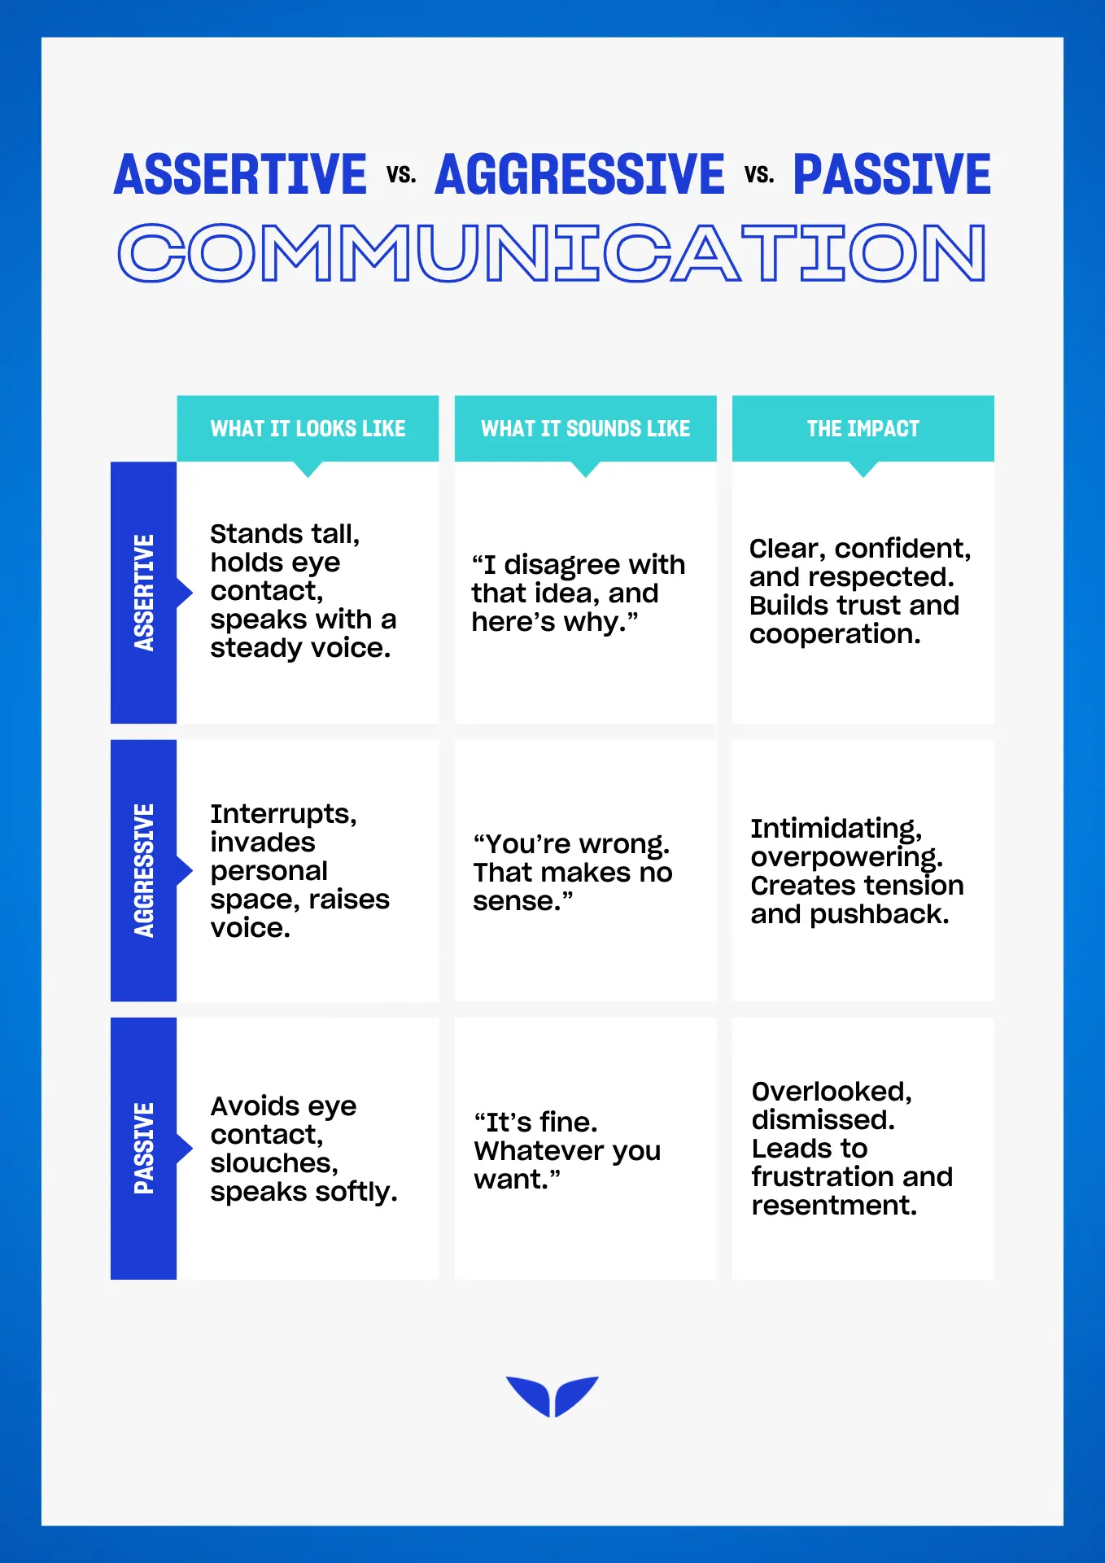
Assertive communication
Passive communication avoids conflict.
Aggressive communication wins conflict.
Assertive communication resolves conflict.

Slide 27
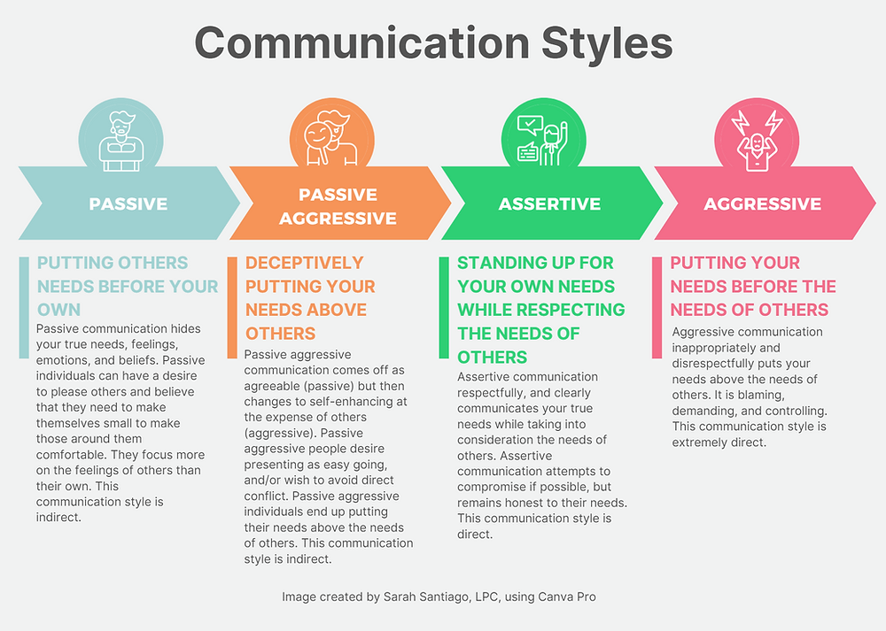

Slide 28
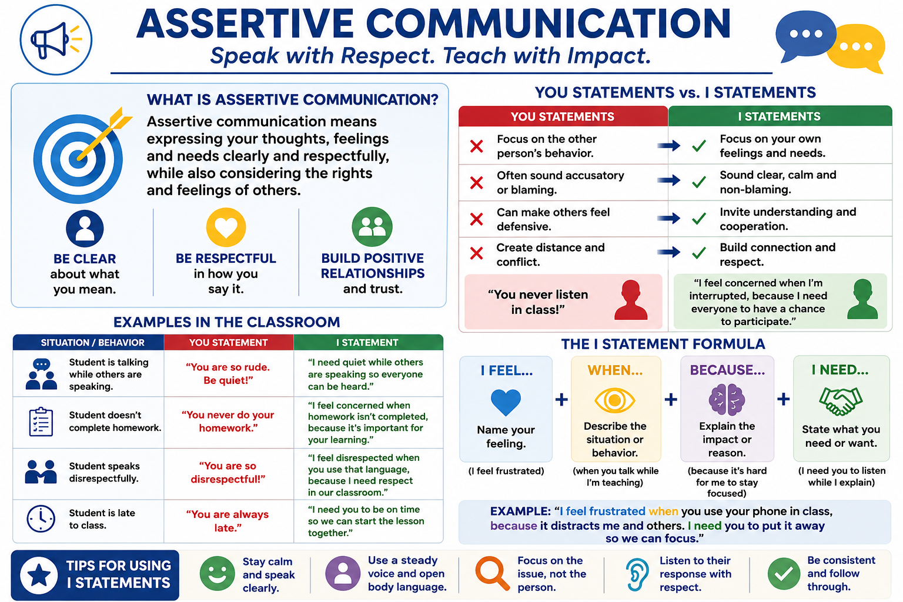

Slide 29
"You never listen!" → "I feel frustrated when I'm interrupted because I want everyone to have a chance to speak."
"You're being disrespectful!" → "I feel concerned when hurtful language is used because I want our classroom to be respectful for everyone."
"You never do your homework!" → "I'm concerned when homework isn't completed because it's important for your learning and progress."
"You're always talking!" → "I'm finding it difficult to continue the lesson while conversations are happening because everyone deserves to hear the instructions."
"You're late again!" → "I'm concerned when lessons start late because it disrupts the learning of the whole class. I'd like us to begin on time."

Slide 30
Activity: write it better
Transform “you” to “I” statements

Slide 31
Being Firm Without Losing Respect
Empathy does not mean accepting inappropriate behaviour. An inclusive classroom requires both care and clear boundaries.
Remember:
- Validate emotions, but set limits on behaviour.
- Correct the behaviour, not the student's character.
- Stay calm, consistent, and predictable.
- Avoid power struggles in front of the class.
- Follow through with realistic consequences every time.
Examples:
"I understand you're frustrated. I will not allow disrespectful language."
"You don't have to agree with me, but you do have to follow classroom expectations."
"The discussion is over. We are continuing with the lesson.“
Students respect teachers whose expectations are clear and whose actions are fair and consistent.

Slide 32
What is the Restorative Framework?
The Restorative Paradigm: What harm was caused, who was affected, and how can we repair it?
Classroom Example
Situation - A student laughs loudly after a classmate gives an incorrect answer.
Traditional Response
"Stop laughing. That was disrespectful. You'll stay behind after class.“ - to be fair, also works sometimes ☺ ☺
Restorative Response
Teacher:
"Let's talk for a moment. What happened from your perspective?"
Student:
"I laughed because I thought it was funny."
Teacher:
"How do you think your classmate felt when that happened?"
Student:
"Probably embarrassed."
Teacher:
"What could you do now to help repair the situation?"
The Five Restorative Questions
What happened?
What were you thinking and feeling at the time?
Who has been affected by what happened?
What do you think they need now?
What can you do to repair the harm?

Slide 33
Restorative practice
Proactive Practice: Community Circles
Example: A 10-minute check-in at the start of the week. Students share one thing they need from the group to feel focused and respected.
Reactive Practice: The 3-Question Reset Card
Use these three prompts instead of assigning blame when a conflict erupts:
  What happened, and what were you thinking at the time?
  Who has been affected by your actions, and in what way?
  What do you think needs to happen to make things right?

Slide 34
When Students Refuse or Challenge Authority
Practical strategies:
1. Give one clear instruction—avoid repeated warnings.
2. Do not argue publicly; reduce the audience whenever possible.
3. Separate the student from the behaviour: "Your behaviour is unacceptable," not "You are disrespectful.“
4. Use calm, brief language instead of emotional reactions.
5. Apply consequences that are immediate, proportional, and consistent.
6. Know when to involve parents, school leadership, or support staff—serious or repeated incidents require a team approach!
Some students will test boundaries. Not every strategy will work every time, and no teacher can guarantee compliance.
The goal is to protect the learning environment, not to "win" an argument.
Key principle: High expectations + High support = Effective classroom management.

Slide 35
De-escalation: Staying in Control
What to do:
Speak more slowly and quietly instead of raising your voice.
Give short, clear instructions—avoid long lectures.
Use pauses and silence strategically.
Maintain neutral body language and avoid sarcasm.
Address the student privately whenever possible.
Examples:
"We'll discuss this after the lesson. Right now, I'm teaching."
"You have a choice: participate appropriately or accept the consequences according to our classroom rules."
"I'm not arguing with you. I'm asking you to follow the classroom expectations."
Remember: The calmer the teacher remains, the fewer opportunities students have to turn the situation into a power struggle.

Slide 36
How to deal with:
Repeated Swearing –
"This is f***ing bullshit.“ → "I can hear that you're angry. Swearing at school is not acceptable. You have a choice: we can continue this lesson respectfully, or we'll follow the school's behaviour procedure after class. The choice is yours.“
Student Keeps Interrupting –
"I don't care what you say.“ →"You don't have to agree with me. You do have to respect the expectations of this classroom. If the interruptions continue, I'll document today's incident and we'll involve your parents and the school counsellor. I'd rather spend that time helping you succeed."

Slide 37
How to deal with:
3. Personal insults - "You're a terrible teacher.“ →"You're allowed to disagree with me. Personal insults cross a boundary. If they continue, I'll end this conversation and we'll continue it with another member of staff present.“
4. Student refuses every instruction - "Right now you're choosing not to participate. That's your decision. If that choice continues, it will have the consequences outlined in our school policy. I'm giving you the opportunity to make a different choice.“
5. Escalating aggression - "I'm going to ask you to lower your voice and remain where you are. If I believe anyone's safety is at risk, I'll immediately follow our school's safety procedure."

Slide 38
Final simulation

Slide 39
Personal action plan

Slide 40
Thank you ☺
Thank you for investing not only in your professional growth, but in the lives of every student you will meet.
The impact of one caring teacher lasts far beyond the classroom.

Slide 41
How to prevent burnout?
Protect your nervous system during the work day (2-5 minutes decompression rituals)
Separate compassion from over-functioning (the need to fix everything)
Create emotional boundaries without becoming cold
Reduce invisible labor (Your memory should not be your primary organizational system)
Watch for “compassion fatigue” signs
Build support with people who understand the work
Protect your identity outside teaching (when teaching becomes our whole identity)
Make the job more sustainable instead of trying to “push through”
Ask for help!

